Slide 1
Design and Analysis of Algorithms
Algorithms-II : CS345A
Lecture 13
A powerful technique to
traverse a directed graph

Slide 2
Recap of last lecture

Slide 3

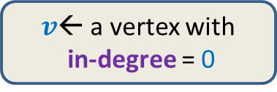
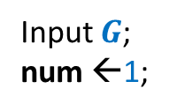
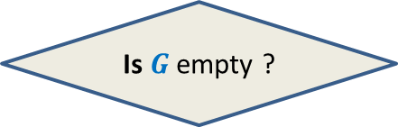
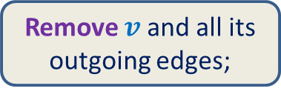
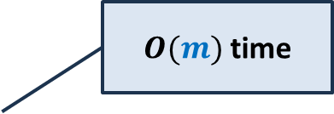
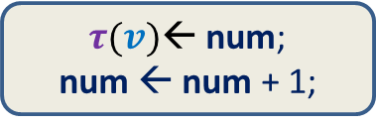

Algorithm for Topological ordering
$O(m)$ time
Time complexity of the algorithm: ?
$O(mn)$
Input $G$;
num ←1;
$v$← a vertex with
in-degree = 0
$τ(v)$← num;
num ← num + 1;
Remove $v$ and all its outgoing edges;
Yes
NO
Is $G$ empty ?
A valid $τ$

Slide 4
How to efficiently maintain
the set of vertices with in-degree=0?
Queue

Slide 5

Algorithm for Topological ordering
Topological-ordering($G$)
{ Create-queue($Q$);
For each $x∈V$ {
if (in-degree[$x$] = 0)
En-queue($x$,$Q$) }
num ← 1;
While( ? )
$v$← De-queue($Q$);
$τ$($v$) ← num;
num ← num + 1;
For each ($v,x$) $∈E$ do
in-degree[$x$] ← in-degree[$x$] – 1;
if (in-degree[$x$] = 0) En-queue($x$,$Q$);
not-empty($Q$)
{
O($deg(v)$) time
{
?
}
} return $τ$ ;
How to show that time complexity is $O(m+n)$?

Slide 6
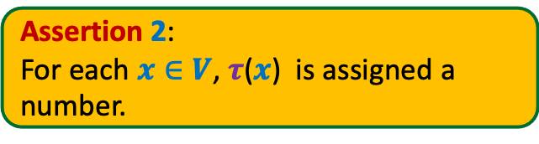
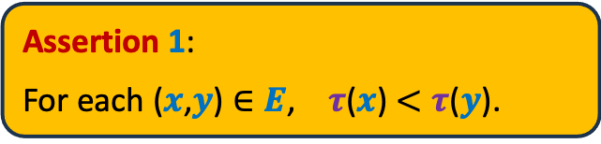
Algorithm for Topological ordering
Topological-ordering($G$)
{ Create-queue($Q$);
For each $x∈V$ {
if (in-degree[$x$] = 0)
En-queue($x$,$Q$) }
num ← 1;
While( ? )
$v$← De-queue($Q$);
$τ$($v$) ← num;
num ← num + 1;
For each ($v,x$) $∈E$ do
in-degree[$x$] ← in-degree[$x$] – 1;
if (in-degree[$x$] = 0) En-queue($x$,$Q$);
Assertion 1:
For each ($x$,$y$) $∈E$, $τ$($x$) $<τ$($y$).
Assertion 2:
For each $x∈V$, $τ$($x$) is assigned a
number.
not-empty($Q$)
{
{
What is the proof of correctness ?
}
} return $τ$ ;
Proof was discussed in Optional Doubt Clearing session on 2nd September.
Instructor inserted the following slides for the proof.

Slide 7
Topological Numbering of a DAG

Slide 8



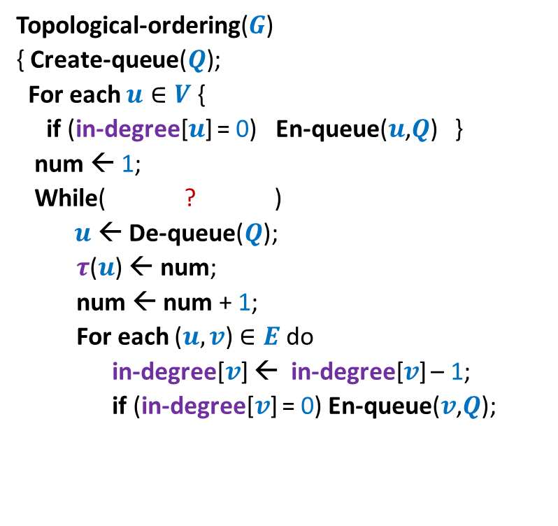




Algorithm for Topological ordering
Assertion 1:
For each ($x$,$y$) $∈E$, $τ$($x$) $<τ$($y$).
For each vertex $u$,
Topological-ordering($G$)
{ Create-queue($Q$);
For each $u∈V$ {
if (in-degree[$u$] = 0) En-queue($u$,$Q$) }
num ← 1;
While( ? )
$u$← De-queue($Q$);
$τ$($u$) ← num;
num ← num + 1;
For each ($u,v$) $∈E$ do
in-degree[$v$] ← in-degree[$v$] – 1;
if (in-degree[$v$] = 0) En-queue($v$,$Q$);
not-empty($Q$)
{
In-degree[$u$] ← 0
En-queue($u$, $Q$);
What is the order in which these 2 events happen ?
{
?
$u$← De-queue($Q$);
}
$τ$($u$) ← num;
} return $τ$ ;
}

Slide 9
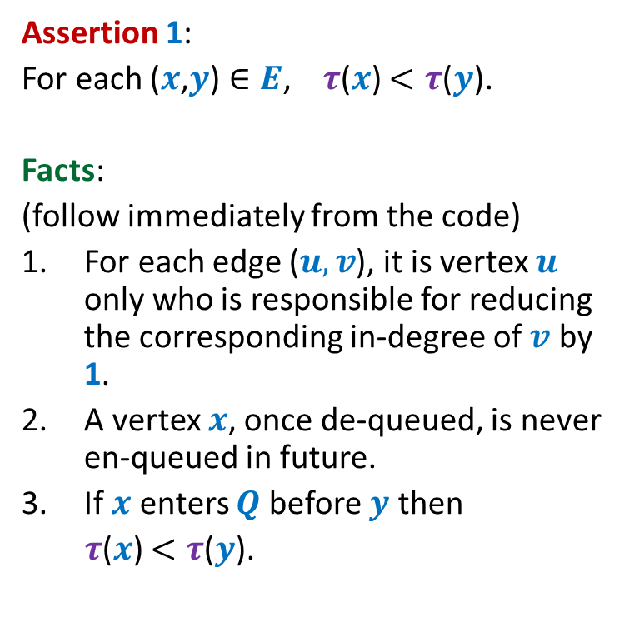
Algorithm for Topological ordering
Assertion 1:
For each ($x$,$y$) $∈E$, $τ$($x$) $<τ$($y$).
Facts:
(follow immediately from the code)
For each edge ($u,v$), it is vertex $u$ only who is responsible for reducing the corresponding in-degree of $v$ by 1.
A vertex $x$, once de-queued, is never en-queued in future.
If $x$ enters $Q$ before $y$ then
$τ$($x$) $<τ$($y$).
Topological-ordering($G$)
{ Create-queue($Q$);
For each $u∈V$ {
if (in-degree[$u$] = 0) En-queue($u$,$Q$) }
num ← 1;
While( ? )
$u$← De-queue($Q$);
$τ$($u$) ← num;
num ← num + 1;
For each ($u,v$) $∈E$ do
in-degree[$v$] ← in-degree[$v$] – 1;
if (in-degree[$v$] = 0) En-queue($v$,$Q$);
not-empty($Q$)
{
{
}
A vertex is enqueued only when it loses its last edge (causing its in-degree to become 0). So it is enqueued at most once.
} return $τ$ ;
}
Due to FIFO nature of Queue

Slide 10





Algorithm for Topological ordering
Assertion 1:
For each ($x$,$y$) $∈E$, $τ$($x$) $<τ$($y$).
Topological-ordering($G$)
{ Create-queue($Q$);
For each $u∈V$ {
if (in-degree[$u$] = 0) En-queue($u$,$Q$) }
num ← 1;
While( ? )
$u$← De-queue($Q$);
$τ$($u$) ← num;
num ← num + 1;
For each ($u,v$) $∈E$ do
in-degree[$v$] ← in-degree[$v$] – 1;
if (in-degree[$v$] = 0) En-queue($v$,$Q$);
En-queue($x$, $Q$);
not-empty($Q$)
{
$x$← De-queue($Q$);
{
In-degree[$y$] ← 0
En-queue($y$, $Q$);
}
} return $τ$ ;
}

Slide 11


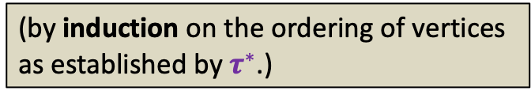
Algorithm for Topological ordering
Assertion 1:
For each ($x$,$y$) $∈E$, $τ$($x$) $<τ$($y$).
Assertion 2:
For each $x∈V$, $τ$($x$) is assigned a
number.
Proof:
Let $τ^{∗}$ be any topological numbering of
vertices of $G$.
Topological-ordering($G$)
{ Create-queue($Q$);
For each $u∈V$ {
if (in-degree[$u$] = 0) En-queue($u$,$Q$) }
num ← 1;
While( ? )
$u$← De-queue($Q$);
$τ$($u$) ← num;
num ← num + 1;
For each ($u,v$) $∈E$ do
in-degree[$v$] ← in-degree[$v$] – 1;
if (in-degree[$v$] = 0) En-queue($v$,$Q$);
Are we done ?
not-empty($Q$)
{
No.
What is the guarantee that $τ$($x$) is assigned a number during the algorithm.
{
(by induction on the ordering of vertices
as established by $τ^{∗}$.)
}
} return $τ$ ;
}

Slide 12


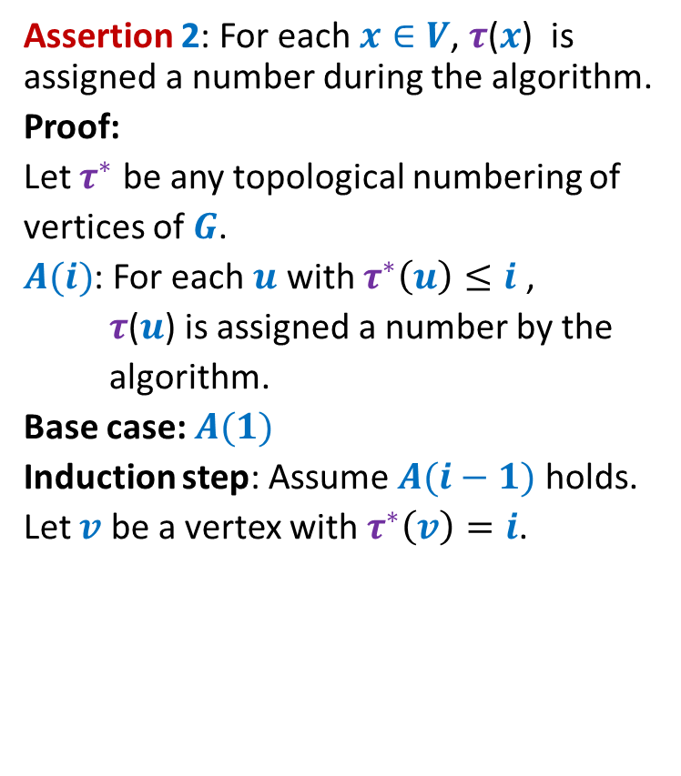



Algorithm for Topological ordering
Assertion 2: For each $x∈V$, $τ$($x$) is assigned a number during the algorithm.
Proof:
Let $τ^{∗}$ be any topological numbering of
vertices of $G$.
$A(i)$: For each $u$ with $τ^{∗}\left(u\right)≤i$ ,
$τ$($u$) is assigned a number by the
algorithm.
Base case: $A(1)$
Induction step: Assume $A(i−1)$ holds.
Let $v$ be a vertex with $τ^{∗}\left(v\right)=i$.
Topological-ordering($G$)
{ Create-queue($Q$);
For each $u∈V$ {
if (in-degree[$u$] = 0) En-queue($u$,$Q$) }
num ← 1;
While( ? )
$u$← De-queue($Q$);
$τ$($u$) ← num;
num ← num + 1;
For each ($u,v$) $∈E$ do
in-degree[$v$] ← in-degree[$v$] – 1;
if (in-degree[$v$] = 0) En-queue($v$,$Q$);
not-empty($Q$)
{
{
}
$$u$$
$$v$$
} return $τ$ ;
}
In-degree[$v$] ← 0
En-queue($v$, $Q$);

Slide 13

Algorithm for Topological ordering
Assertion 2: For each $x∈V$, $τ$($x$) is assigned a number during the algorithm.
Proof:
Let $τ^{∗}$ be any topological numbering of
vertices of $G$.
$A(i)$: For each $u$ with $τ^{∗}\left(u\right)≤i$ ,
$τ$($u$) is assigned a number by the
algorithm.
Base case: $A(1)$
Induction step: Assume $A(i−1)$ holds.
Let $v$ be a vertex with $τ^{∗}\left(v\right)=i$.
Topological-ordering($G$)
{ Create-queue($Q$);
For each $u∈V$ {
if (in-degree[$u$] = 0) En-queue($u$,$Q$) }
num ← 1;
While( ? )
$u$← De-queue($Q$);
$τ$($u$) ← num;
num ← num + 1;
For each ($u,v$) $∈E$ do
in-degree[$v$] ← in-degree[$v$] – 1;
if (in-degree[$v$] = 0) En-queue($v$,$Q$);
not-empty($Q$)
{
{
}
$$u$$
$$v$$
} return $τ$ ;
}
In-degree[$v$] ← 0
En-queue($u$, $Q$);

Slide 14

Algorithm for Topological ordering
Assertion 2: For each $x∈V$, $τ$($x$) is assigned a number during the algorithm.
Assertion 1:
For each ($x$,$y$) $∈E$, $τ$($x$) $<τ$($y$).
Theorem:
Topological-ordering($G$) assigns a valid
topological numbering to all vertices of
the DAG $G$.
Topological-ordering($G$)
{ Create-queue($Q$);
For each $u∈V$ {
if (in-degree[$u$] = 0) En-queue($u$,$Q$) }
num ← 1;
While( ? )
$u$← De-queue($Q$);
$τ$($u$) ← num;
num ← num + 1;
For each ($u,v$) $∈E$ do
in-degree[$v$] ← in-degree[$v$] – 1;
if (in-degree[$v$] = 0) En-queue($v$,$Q$);
not-empty($Q$)
{
{
}
} return $τ$ ;
}

Slide 15
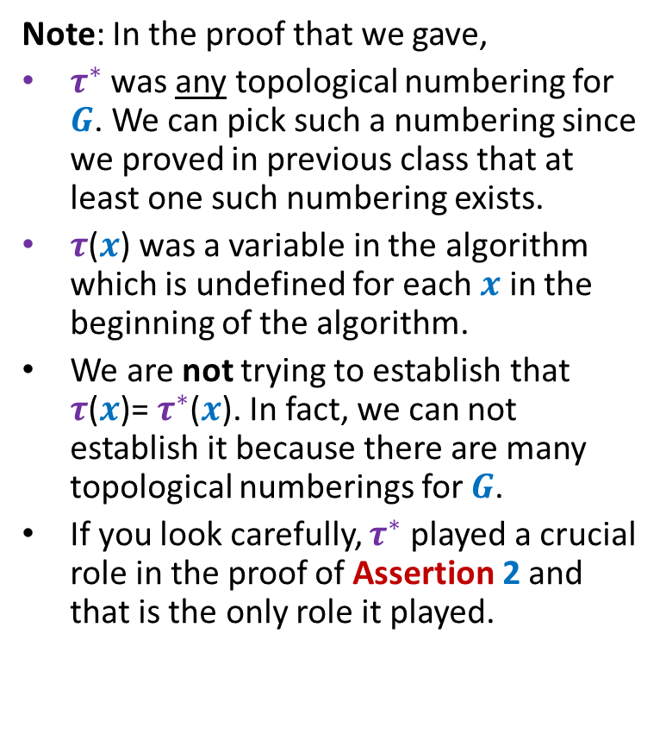
Algorithm for Topological ordering
Note: In the proof that we gave,
$τ^{∗}$ was any topological numbering for $G$. We can pick such a numbering since we proved in previous class that at least one such numbering exists.
$τ$($x$) was a variable in the algorithm which is undefined for each $x$ in the beginning of the algorithm.
We are not trying to establish that $τ$($x$)= $τ^{∗}$($x$). In fact, we can not establish it because there are many topological numberings for $G$.
If you look carefully, $τ^{∗}$ played a crucial role in the proof of Assertion 2 and that is the only role it played.
Topological-ordering($G$)
{ Create-queue($Q$);
For each $u∈V$ {
if (in-degree[$u$] = 0) En-queue($u$,$Q$) }
num ← 1;
While( ? )
$u$← De-queue($Q$);
$τ$($u$) ← num;
num ← num + 1;
For each ($u,v$) $∈E$ do
in-degree[$v$] ← in-degree[$v$] – 1;
if (in-degree[$v$] = 0) En-queue($v$,$Q$);
not-empty($Q$)
{
{
}
} return $τ$ ;
}

Slide 16
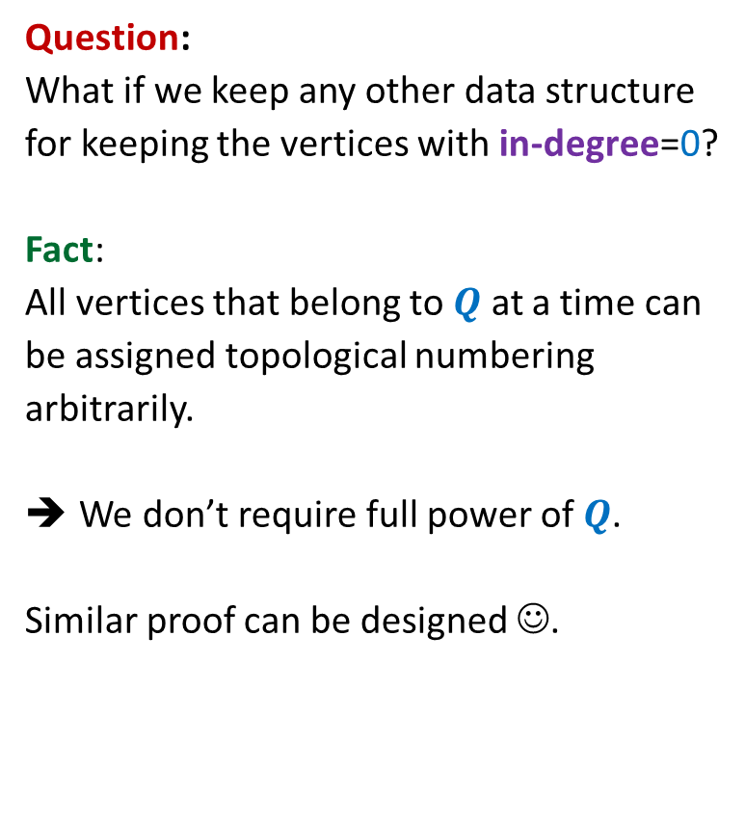
Algorithm for Topological ordering
Question:
What if we keep any other data structure
for keeping the vertices with in-degree=0?
Fact:
All vertices that belong to $Q$ at a time can
be assigned topological numbering
arbitrarily.
We don’t require full power of $Q$.
Similar proof can be designed ☺.
Topological-ordering($G$)
{ Create-queue($Q$);
For each $u∈V$ {
if (in-degree[$u$] = 0) En-queue($u$,$Q$) }
num ← 1;
While( ? )
$u$← De-queue($Q$);
$τ$($u$) ← num;
num ← num + 1;
For each ($u,v$) $∈E$ do
in-degree[$v$] ← in-degree[$v$] – 1;
if (in-degree[$v$] = 0) En-queue($v$,$Q$);
not-empty($Q$)
{
{
}
} return $τ$ ;
}

Slide 17

DEPTH FIRST SEARCH
From a vertex $u$

Slide 18
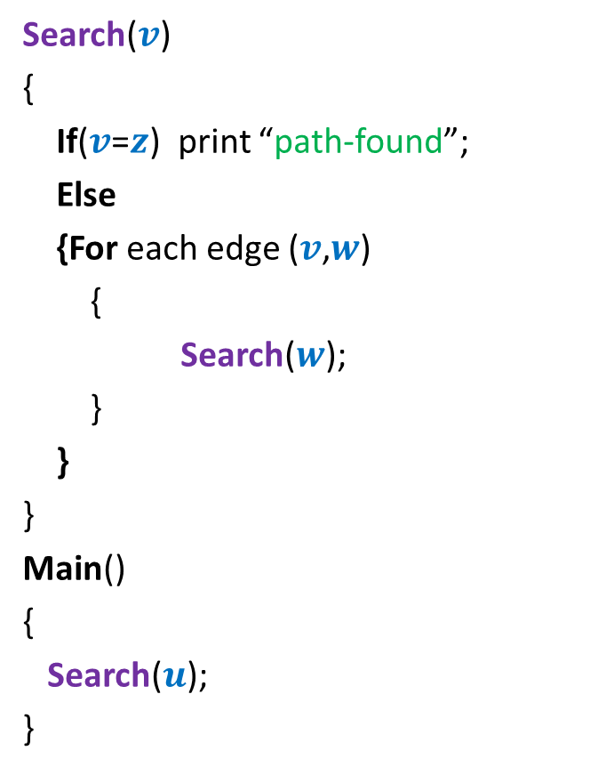




Searching path from $u$ to $z$
Search($v$)
{
If($v$=$z$) print “path-found”;
Else
{For each edge ($v$,$w$)
{
Search($w$);
}
}
}
Main()
{
Search($u$);
}
x
Visited[$v$] ← true;
y
u
s
q
If (Visited[$w$]=false)
w
j
r
p
z
t
For each $v$ $∈V$ Visited[$v$] ← false;
b
d
h
c

Slide 19
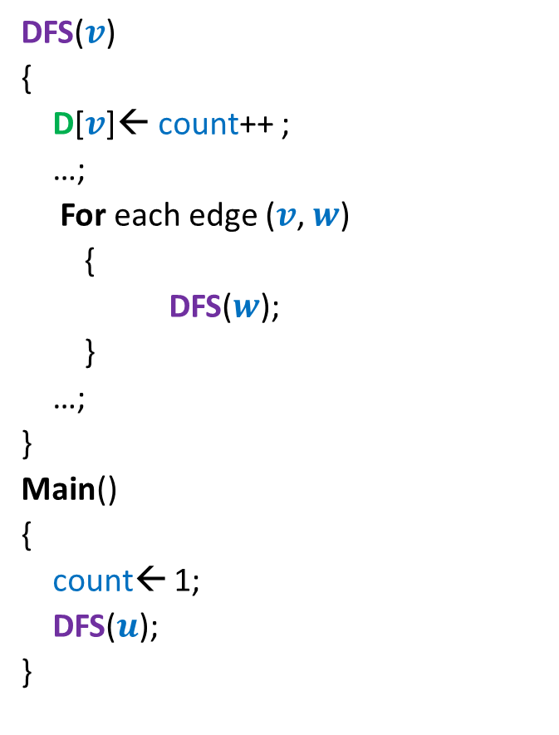


DFS from a vertex $u$
DFS($v$)
{
D[$v$]← count++ ;
…;
For each edge ($v$, $w$)
{
DFS($w$);
}
…;
}
Main()
{
count← 1;
DFS($u$);
}
x
Visited[$v$] ← true;
y
u
s
q
If (Visited[$w$]=false)
w
j
r
p
z
t
For each $v$ $∈$ $V$ Visited[$v$] ← false;
b
d
h
c

Slide 20
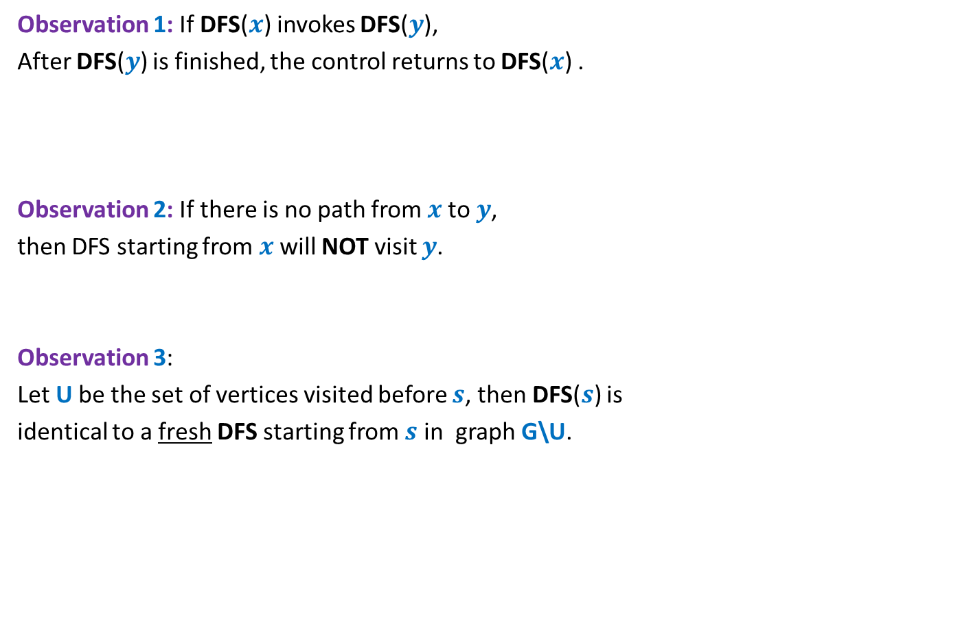

Relation among various DFS() calls
x
Observation 1: If DFS($x$) invokes DFS($y$),
After DFS($y$) is finished, the control returns to DFS($x$) .
Observation 2: If there is no path from $x$to $y$,
then DFS starting from $x$ will NOT visit $y$.
Observation 3:
Let U be the set of vertices visited before $s$, then DFS($s$) is
identical to a fresh DFS starting from $s$ in graph G\U.
y
u
s
q
w
j
r
p
z
t
b
d
If $s$ is not the vertex that starts DFS, how does DFS($s$) behave ?
h
c

Slide 21
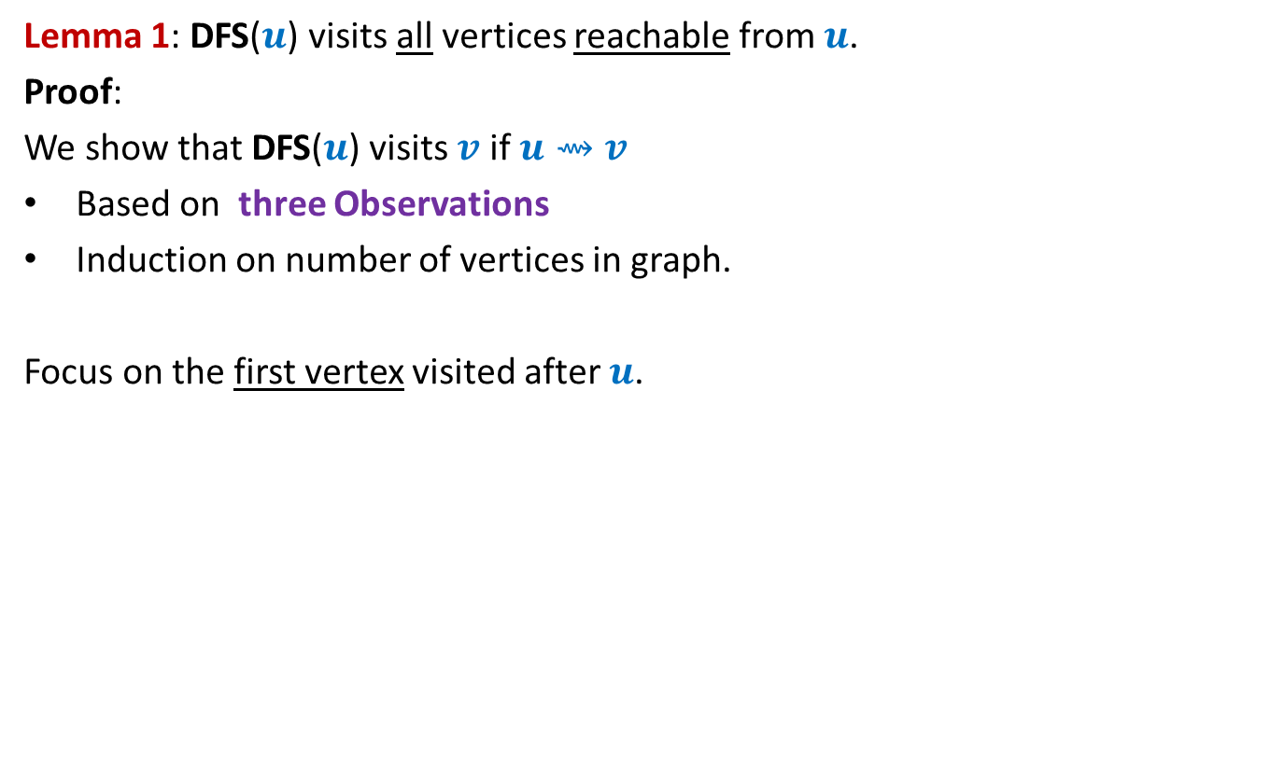
DFS from a vertex $u$
Lemma 1: DFS($u$) visits all vertices reachable from $u$.
Proof:
We show that DFS($u$) visits $v$ if $u⇝v$
Based on three Observations
Induction on number of vertices in graph.
Focus on the first vertex visited after $u$.
x
y
u
s
q
w
j
r
p
v
t

Slide 22
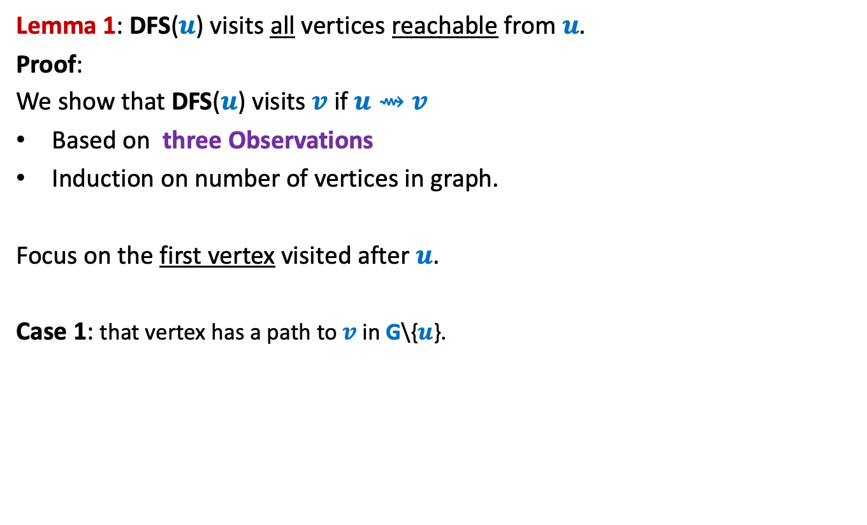
DFS from a vertex $u$
Lemma 1: DFS($u$) visits all vertices reachable from $u$.
Proof:
We show that DFS($u$) visits $v$ if $u⇝v$
Based on three Observations
Induction on number of vertices in graph.
Focus on the first vertex visited after $u$.
Case 1: that vertex has a path to $v$ in G\{$u$}.
x
y
u
s
q
w
j
r
p
v
t

Slide 23
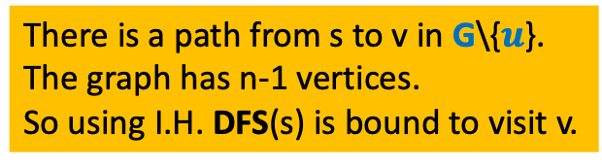
DFS from a vertex $u$
Lemma 1: DFS($u$) visits all vertices reachable from $u$.
Proof:
We show that DFS($u$) visits $v$ if $u⇝v$
Based on three Observations
Induction on number of vertices in graph.
Focus on the first vertex visited after $u$.
Case 1: that vertex has a path to $v$ in G\{$u$}.
x
y
u
s
q
w
j
(use Observation 3)
r
p
Case 2:
v
How can you show that v is visited in this case ?
t
There is a path from s to v in G\{$u$}.
The graph has n-1 vertices.
So using I.H. DFS(s) is bound to visit v.

Slide 24
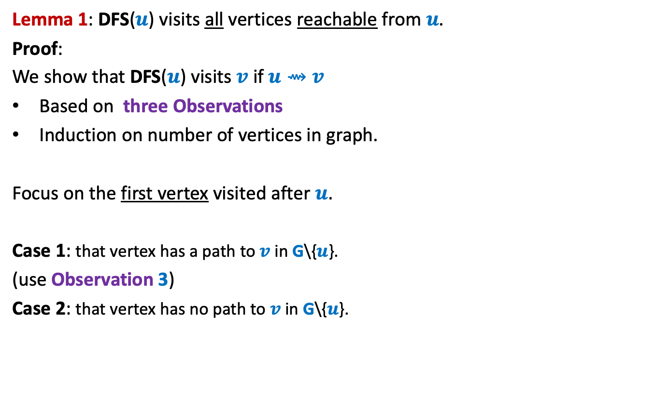
DFS from a vertex $u$
Lemma 1: DFS($u$) visits all vertices reachable from $u$.
Proof:
We show that DFS($u$) visits $v$ if $u⇝v$
Based on three Observations
Induction on number of vertices in graph.
Focus on the first vertex visited after $u$.
Case 1: that vertex has a path to $v$ in G\{$u$}.
(use Observation 3)
Case 2: that vertex has no path to $v$ in G\{$u$}.
x
y
u
s
q
w
j
r
p
v
t

Slide 25
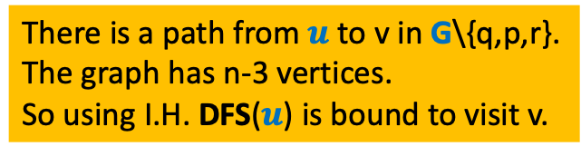
DFS from a vertex $u$
Lemma 1: DFS($u$) visits all vertices reachable from $u$.
Proof:
We show that DFS($u$) visits $v$ if $u⇝v$
Based on three Observations
Induction on number of vertices in graph.
Focus on the first vertex visited after $u$.
Case 1: that vertex has a path to $v$ in G\{$u$}.
(use Observation 3)
Case 2: that vertex has no path to $v$ in G\{$u$}.
x
y
u
s
q
w
j
r
p
(use Observation 1 ,2 and 3)
v
t
How can you show that v is visited in this case ?
There is a path from $u$ to v in G\{q,p,r}.
The graph has n-3 vertices.
So using I.H. DFS($u$) is bound to visit v.

Slide 26

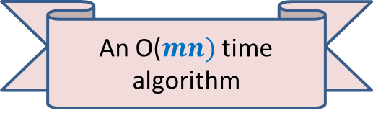
DFS from a vertex $u$
Lemma 1: DFS($u$) visits all vertices reachable from $u$.
Application 1:
Computing reachability from all vertices in graph
It suffices to execute fresh DFS($u$) from each $u∈V$.
An O($mn)$ time algorithm

Slide 27

More insights ABOUT DFS($u$)

Slide 28
DFS from a vertex $u$
x
y
u
s
q
w
j
r
p
v
t

Slide 29
DFS from a vertex $u$
x
y
u
s
q
w
j
r
p
v
t

Slide 30

DFS from a vertex $u$
Lemma 2: DFS($u$) computes a tree on all vertices reachable from $u$.
x
y
u
s
q
w
j
r
p
v
t

Slide 31

DFS from a vertex $u$
Lemma 2: DFS($u$) computes a tree on all vertices reachable from $u$.
Question: Is the DFS tree unique ?
Answer: No. But every tree is also not a DFS tree.
x
y
u
NOT a DFS tree. Can you explain it?
s
Another DFS tree
q
w
j
r
p
Is this a DFS tree ?
v
t

Slide 32

DEPTH FIRST SEARCH
For entire graph $G$

Slide 33
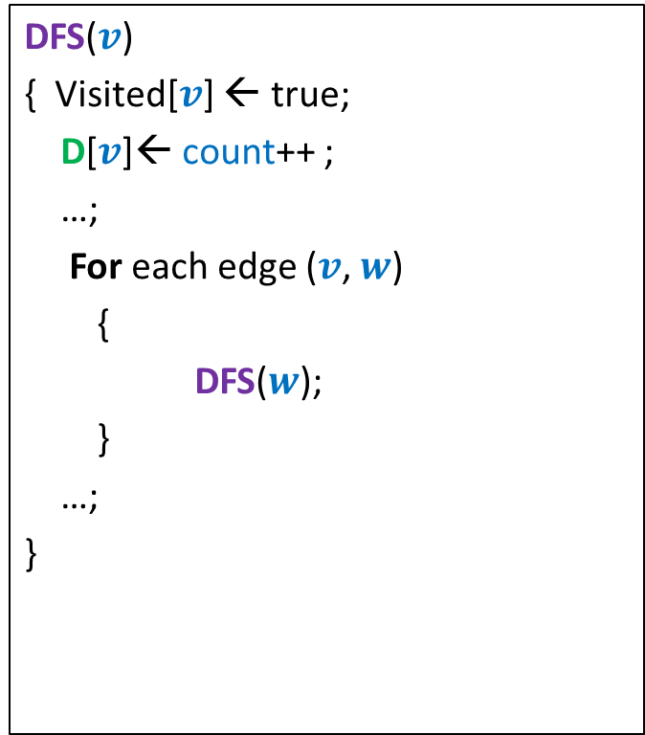
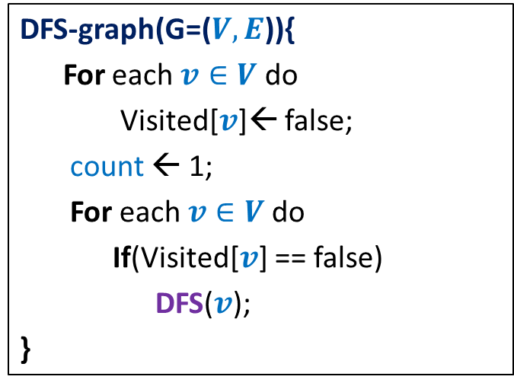
DFS on the graph
DFS($v$)
{ Visited[$v$] ← true;
D[$v$]← count++ ;
…;
For each edge ($v$, $w$)
{
DFS($w$);
}
…;
}
DFS-graph(G=($V,E$)){
For each $v∈V$ do
Visited[$v$]← false;
count ← 1;
For each $v∈V$do
If(Visited[$v$] == false)
DFS($v$);
}
Notes:
Interestingly, adding only a few statements in the code DFS(v) leads to efficient algorithms for a variety of problems.

Slide 34
x
x
y
y
u
u
Lemma 3: DFS partitions the graph into a forest of DFS trees.
v
q
v
q
w
j
w
j
r
p
r
p
k
t
k
t
b
b
d
d
h
h
c

Slide 35
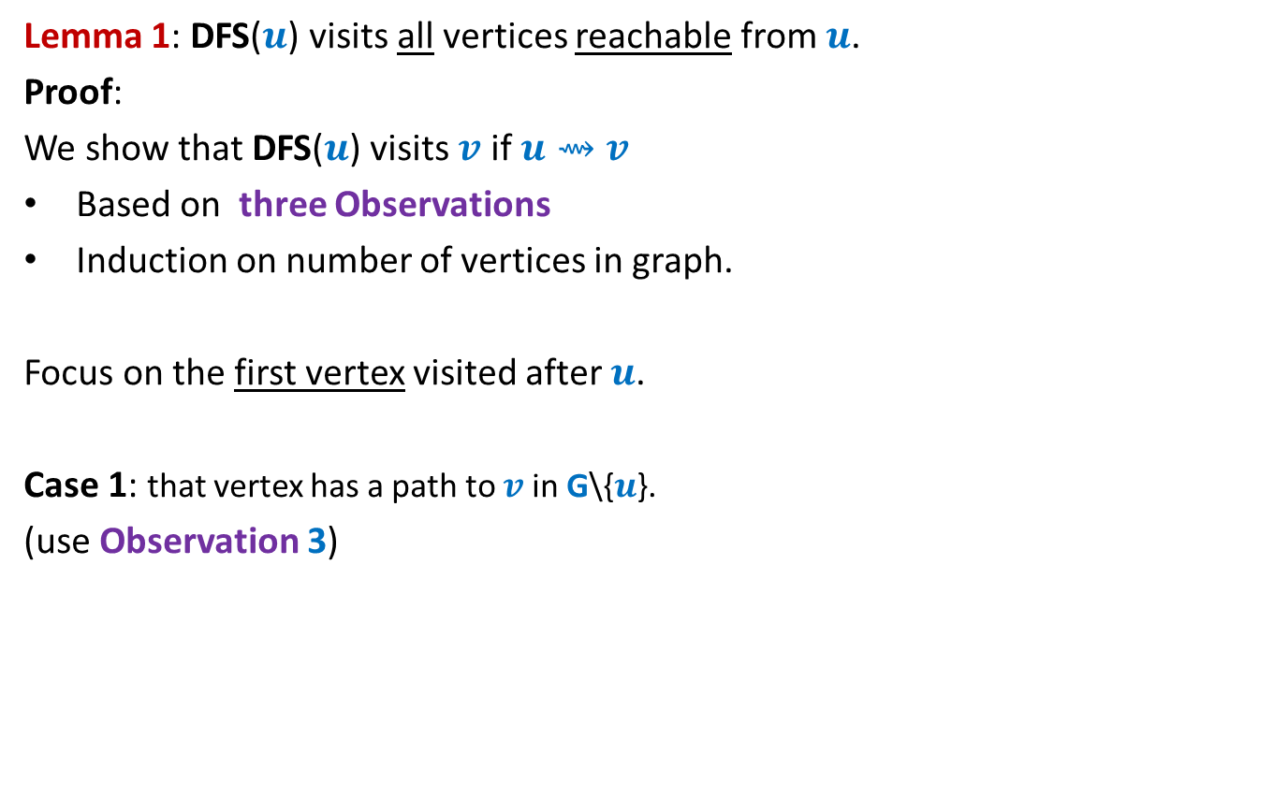
DFS on the graph
DFS($v$)
{ Visited[$v$] ← true;
D[$v$]← count++ ;
…;
For each edge ($v$, $w$)
{ If(Visited[$w$] = false)
DFS($w$);
….
}
…;
}
DFN number of v :
the time when DFS starts at v.
DFS-graph(G=($V,E$)){
For each $v∈V$ do
Visited[$v$]← false;
count ← 1;
For each $v∈V$do
If(Visited[$v$] == false)
DFS($v$);
}
F[$v$]← count++ ;
Finish number of v :
the time when DFS at v ends.
Notes:
Interestingly, adding only a few statements in the code DFS(v) leads to efficient algorithms for a variety of problems.

Slide 36
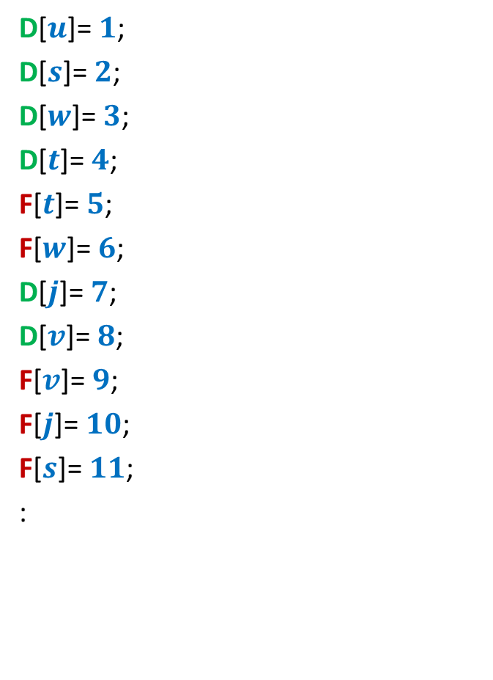
DFS on the graph
Is there any relation between D and F values of any pair of vertices ?
D[$u$]= $1$;
D[$s$]= $2$;
D[$w$]= $3$;
D[$t$]= $4$;
F[$t$]= $5$;
F[$w$]= $6$;
D[$j$]= $7$;
D[$v$]= $8$;
F[$v$]= $9$;
F[$j$]= $10$;
F[$s$]= $11$;
:
x
y
u
s
q
w
j
r
p
v
t

Slide 37





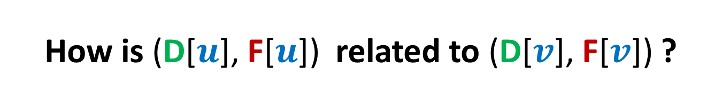








How is (D[$u$], F[$u$]) related to (D[$v$], F[$v$]) ?
Disjoint
One enclosing another
What about D[$u$] < D[$v$] <F[$u$] < F[$v$] ?
D[$u$]
F[$u$]
D[$v$]
F[$v$]
D[$u$]
F[$u$]
D[$v$]
F[$v$]
D[$u$]
F[$u$]
D[$v$]
F[$v$]

Slide 38
Application - I
Alternate algorithm
for topological numbering of a DAG.

Slide 39


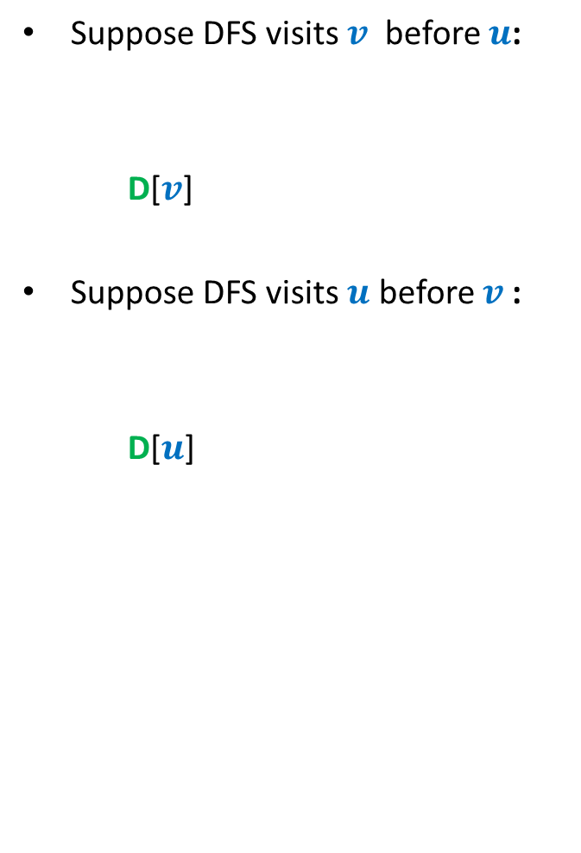



DFS on a DAG
Suppose DFS visits $v$ before $u$:
D[$v$]
Suppose DFS visits $u$ before $v$:
D[$u$]
< F[$v$]
< D[$u$] < F[$u$]
u
< D[$v$] < F[$v$]
< F[$u$]
v
F[$u$] > F[$v$] always !!

Slide 40
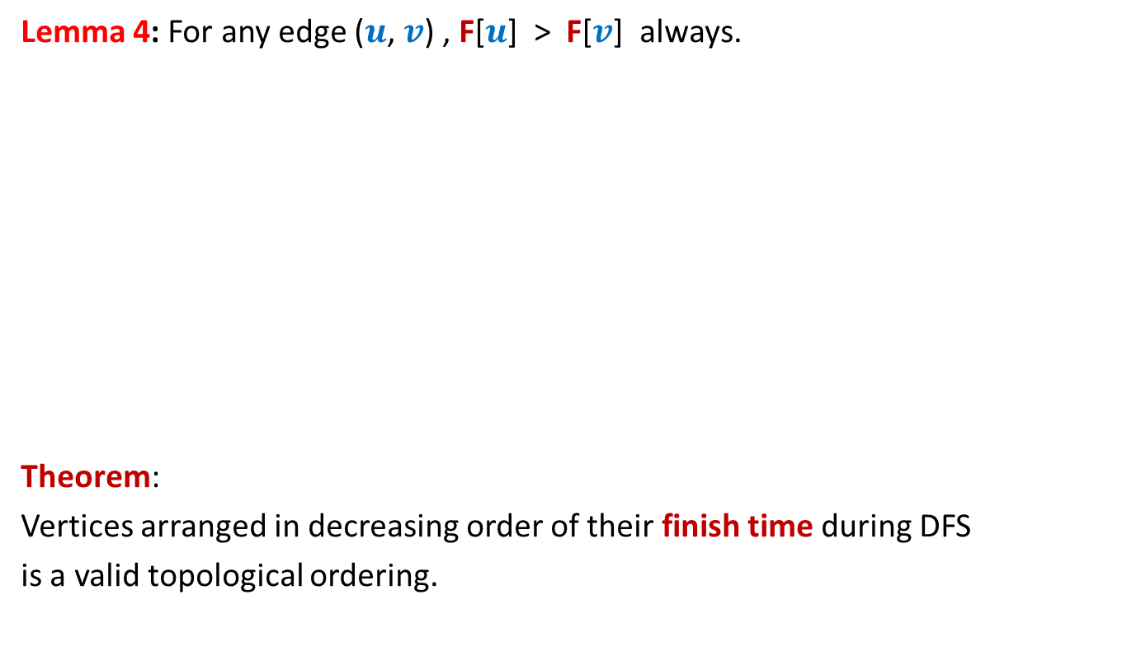
DFS on a DAG
Lemma 4: For any edge ($u$, $v$) , F[$u$] > F[$v$] always.
Theorem:
Vertices arranged in decreasing order of their finish time during DFS
is a valid topological ordering.
Decreasing order of F
1 2 3 4 5 6 7 8 9 10 11

Slide 41
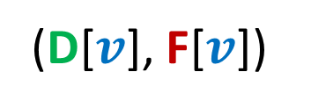
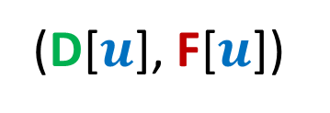
Classification of non-tree edges
using
(D[$u$], F[$u$])
and
(D[$v$], F[$v$])

Slide 42
Classification of non-tree edges
There seems to be many different types of non-tree edges.
x
y
u
s
q
Can we classify the non-tree edges ?
w
j
r
p
v
t
b
d
h
c

Slide 43







($u$,$v$) is Forward edge
$$u$$
$$s$$
$$w$$
$$v$$
D[$u$]
F[$u$]
D[$v$]
F[$v$]

Slide 44

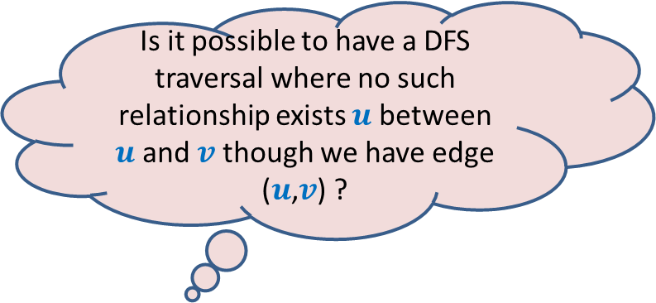









($u$,$v$) is Backward edge
Till now, we considered the situations in which either $u$ is ancestor of $v$ or vice versa.
$$v$$
$$s$$
Is it possible to have a DFS traversal where no such relationship exists $u$ between $u$and $v$ though we have edge ($u$,$v$) ?
$$w$$
Yes, indeed.
Think over it before coming to the next lecture.
$$u$$
D[$v$]
F[$v$]
D[$u$]
F[$u$]

